Slide 1



Project 5:
Data visualization and reporting in Streamlit
Date: Monday Jan. 17th 2022
Group 4 Presentation
IBM Attrition
Presented by:
Ingrid Mongori Yondo
Sandrine Prevot
Nadim Saad

Slide 2
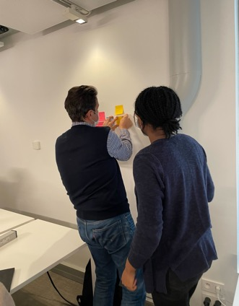
Project Goal
100%
Our goal is to prepare the data and train more in Python and Streamlit
Plan our work using Kanban board
Examine the IBM attrition dataset
Clean & analyse the data using: statistics, crosstab, groupby, pivots, and charts
Develop a Streamlit dashboard (slider, checkboxes) with widgets of our most powerful insights
Prepare the Readme.md file, this presentation and GitHub
Energy
100%
Goodwill
20%
Sleep
We Believe we can do it😎

Slide 3
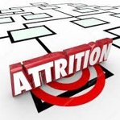
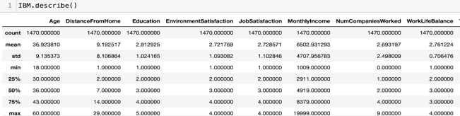


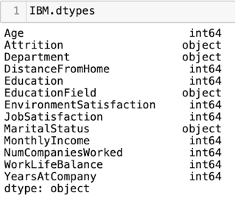
Description of our dataset
Attrition at IBM
Employees attrition refers to employees who leave their jobs due to normal life circumstances;
Employees turnover refers to people who quit their jobs because they don't like them.
Both cost you money, but with a few tweaks, you can reduce your turnover rate.
Our dataset is about Attrition at IBM
Data in 13 columns
No specific year
Monthly Income
Data was clean

Slide 4


Challenges
Finding the rightful correlation method (Phik)
Analysing the data and deciding what to do
Using groupby, pivots and plotting the charts
Tools handling: Streamlit (checkboxes, slider, widgets) and coding in Python
Teamwork and distribution of the tasks

Slide 5
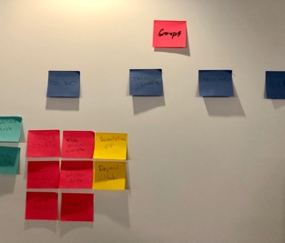
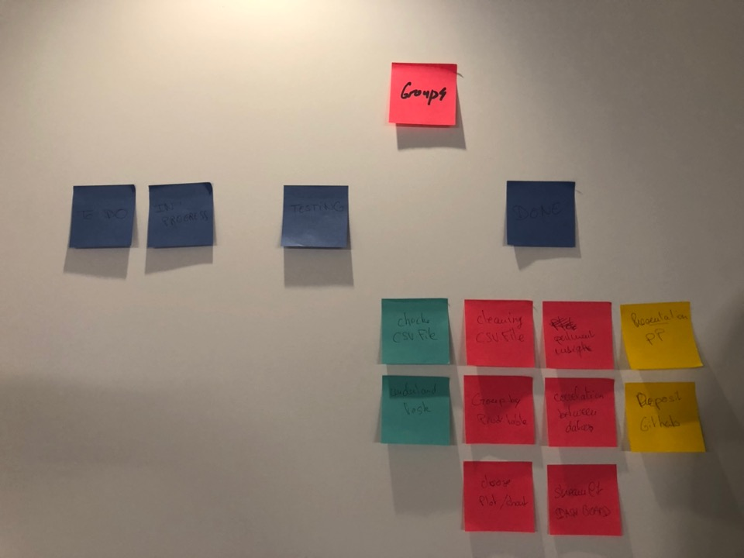
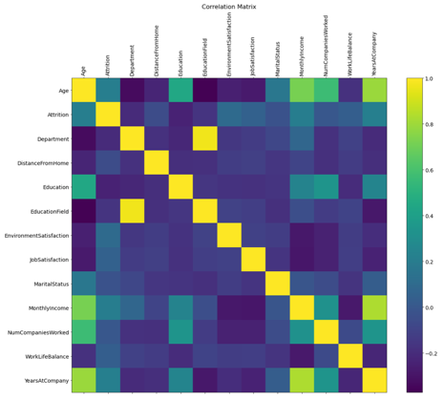
From
To
Process
Understand the task at hand
Check the csv file
Do the data cleaning (no major changes)
Correlate between categorical variables using the Phik method (Attrition vs. Age, Monthly income, Years at the company)
Group the data (pivot table, etc.) (Our prime focus is on Attrition)
Choose the best plots/ charts
Come up with our preliminary insights
Create the Streamlit Dashboard (widgets, slider, etc. codes to visualise our plots)
Notes:
Photo by Christopher Campbell on Unsplash
Photo by Luis Villasmil on Unsplash
Photo by Craig McKay on Unsplash
Photo by Jonas Kakaroto on Unsplash

Slide 6
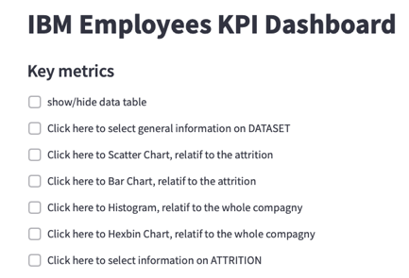
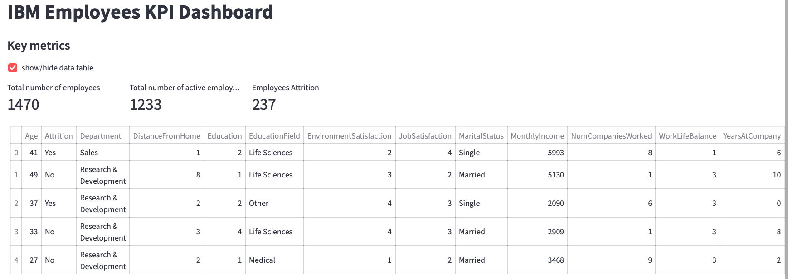
This is our Streamlit
Learnings
Improvements
How to use Streamlit
Data visualization
Understanding the logic
How to create select boxes
Adding extra libraries (chart studio and Plotly)
Create widgets and checkboxes
How to link every plot created on python with Streamlit
Finalize the job
The more we practice, we better we become
It is rewarding to see our plots taking form on Streamlit
We respected IBM colors code

Slide 7
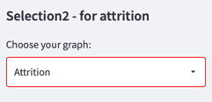
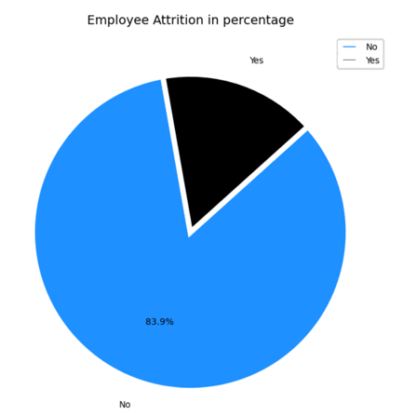
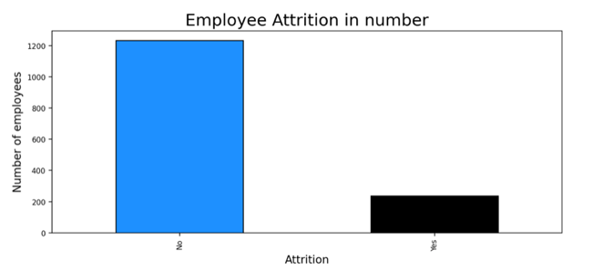
Highlights 1/7
16.1%

Slide 8
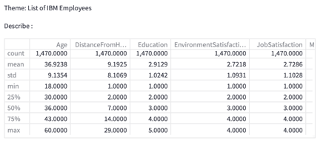

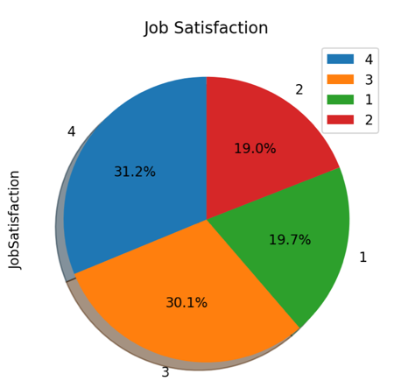
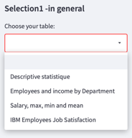
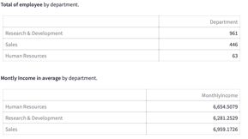
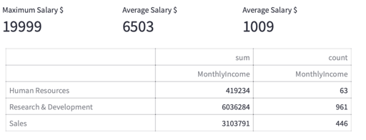
Highlights 2/7

Slide 9
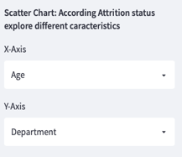
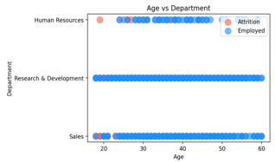
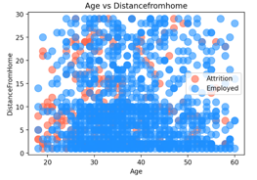
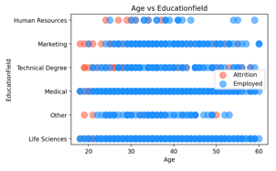
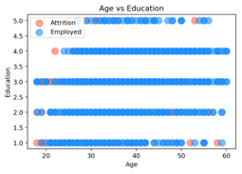
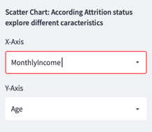
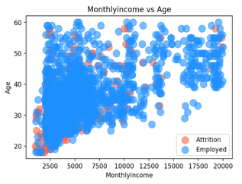
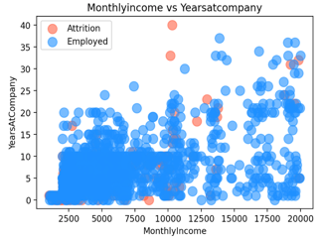
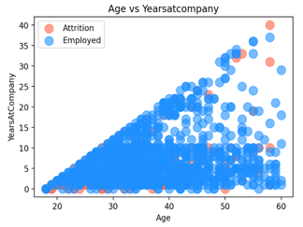
Highlights 3/7

Slide 10
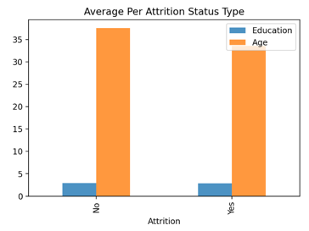
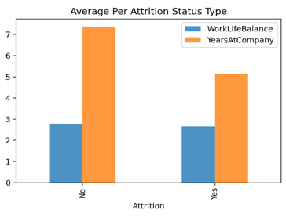
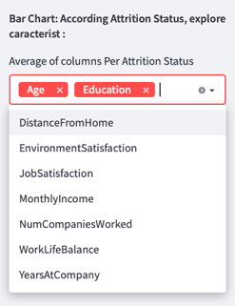
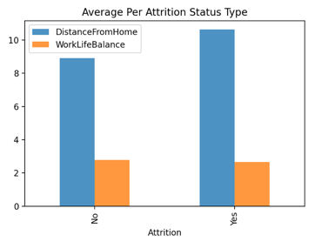
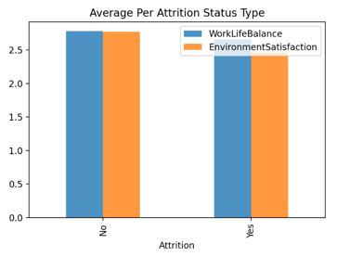
Highlights 4/7

Slide 11
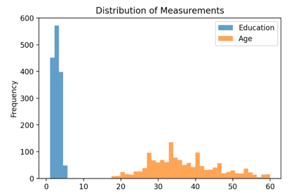
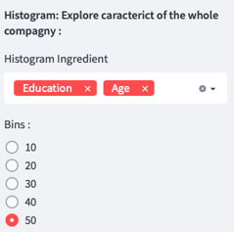
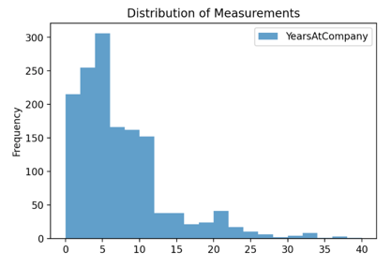
Highlights 5/7

Slide 12
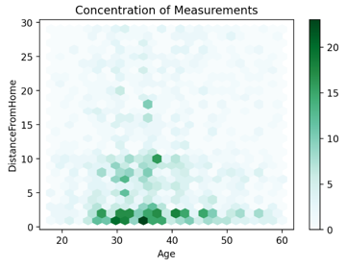
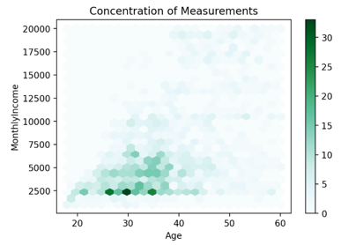
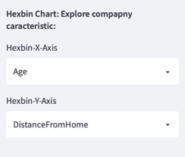
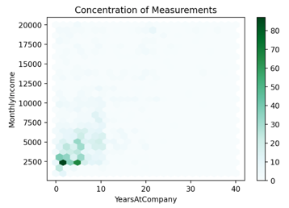
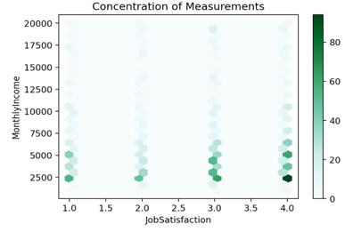
Highlights 6/7

Slide 13



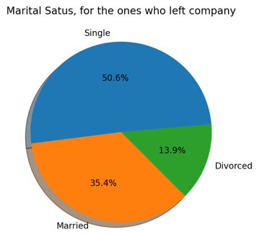
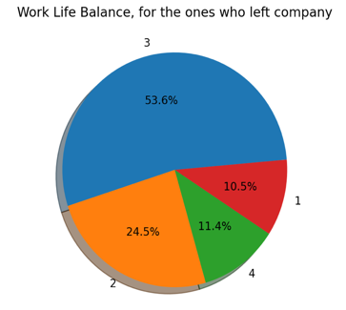
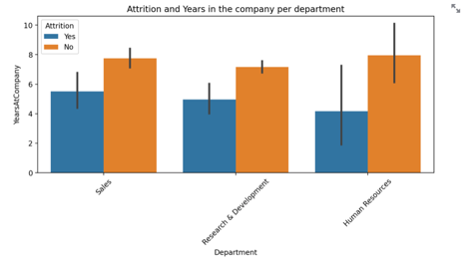
Highlights 7/7

Slide 14

Any Questions?
Notes:
Image by <a href="https://pixabay.com/users/RyanMcGuire-123690/?utm_source=link-attribution&amp;utm_medium=referral&amp;utm_campaign=image&amp;utm_content=362164">Ryan McGuire</a> from <a href="https://pixabay.com/?utm_source=link-attribution&amp;utm_medium=referral&amp;utm_campaign=image&amp;utm_content=362164">Pixabay</a>

